Slide 1
Employee Performance & Productivity
Full Workforce Analytics — Findings, Models & Recommendations
100,000 employees · 9 departments · 7 job titles · hires 2014 – 2024
Automated analytics pipeline · September 2026

Slide 2
Agenda
1
Executive summary & KPIs
2
Workforce composition
3
Compensation & pay equity
4
Performance analysis
5
Attrition & predictive models
6
Workload, remote work & balance
7
Key takeaways & recommendations
8
Methodology
Employee Performance & Productivity Analytics · 100,000 employees · 2026
2

Slide 3
Executive Summary
Six numbers and one surprising negative result
$6,403
avg monthly salary
3.00/5
avg performance
10.0%
attrition rate
3.00/5
avg satisfaction
4.5 yrs
avg tenure
45 hrs
avg work week
✓ Pay equity is healthy — women earn $4.50/mo more on average; within-title gaps ≤ ±$25 (<0.4%).
✓ Salary is a formula: job-title premium (±$2,600) + $493 per performance point — model R² = 0.99.
✗ Attrition (10.0%) is statistically unpredictable — both ML models score AUC ≈ 0.49 (coin flip); every segment sits within 9.5–10.3%.
✗ Engagement levers (training, overtime, remote work, team size) show zero measured effect: |r| < 0.01 vs performance & satisfaction.
⚑ Departments are near-identical on every metric (salary spread $39, attrition spread 0.9 pt) — consistent with synthetic data.
Employee Performance & Productivity Analytics · 100,000 employees · 2026
3

Slide 4
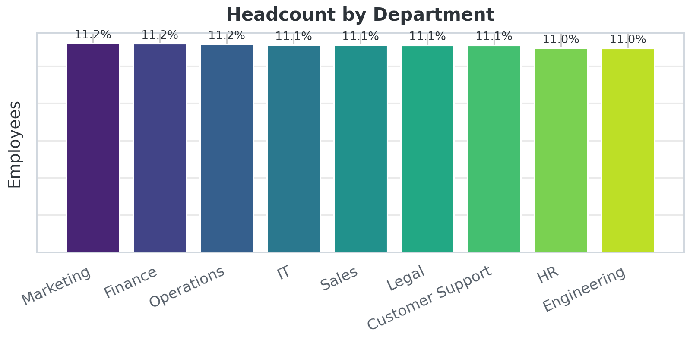
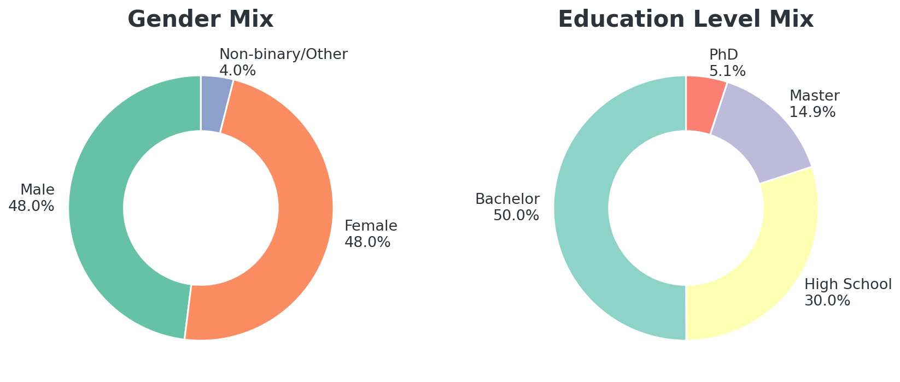
Workforce Composition
Evenly balanced across departments, gender and education
All 9 departments employ 10,956–11,216 staff (11% each).
Education skews to Bachelor; ~9,300 hires/year over the decade.
Employee Performance & Productivity Analytics · 100,000 employees · 2026
4

Slide 5
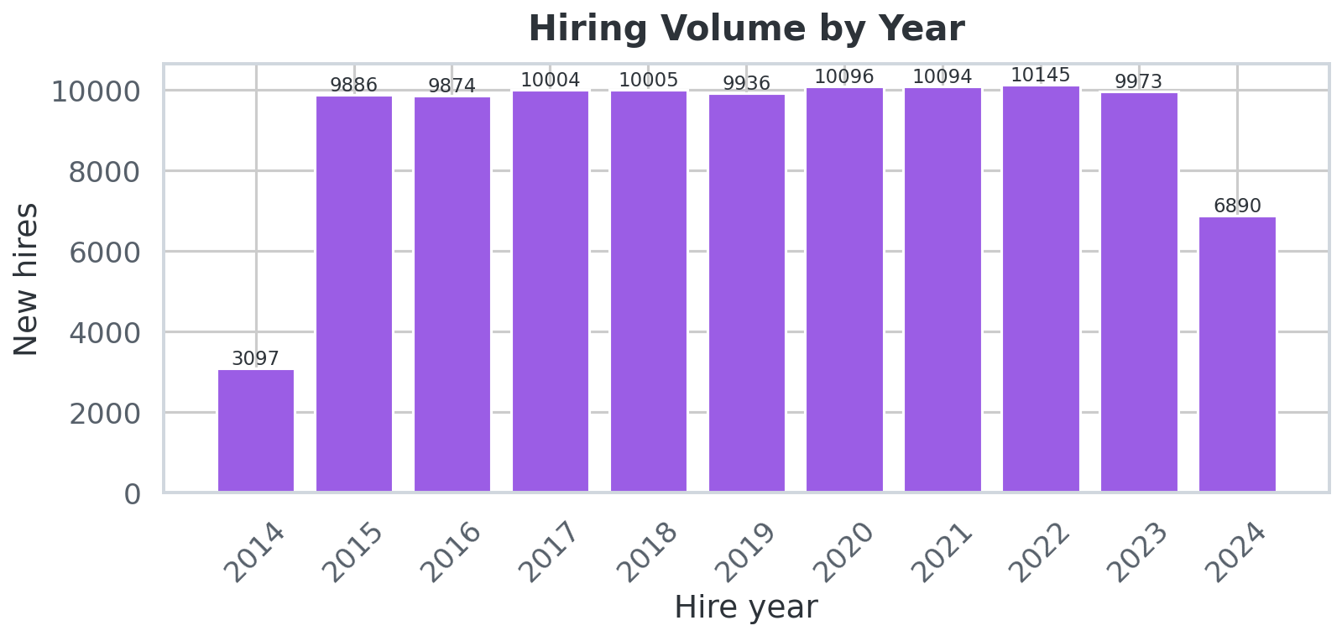
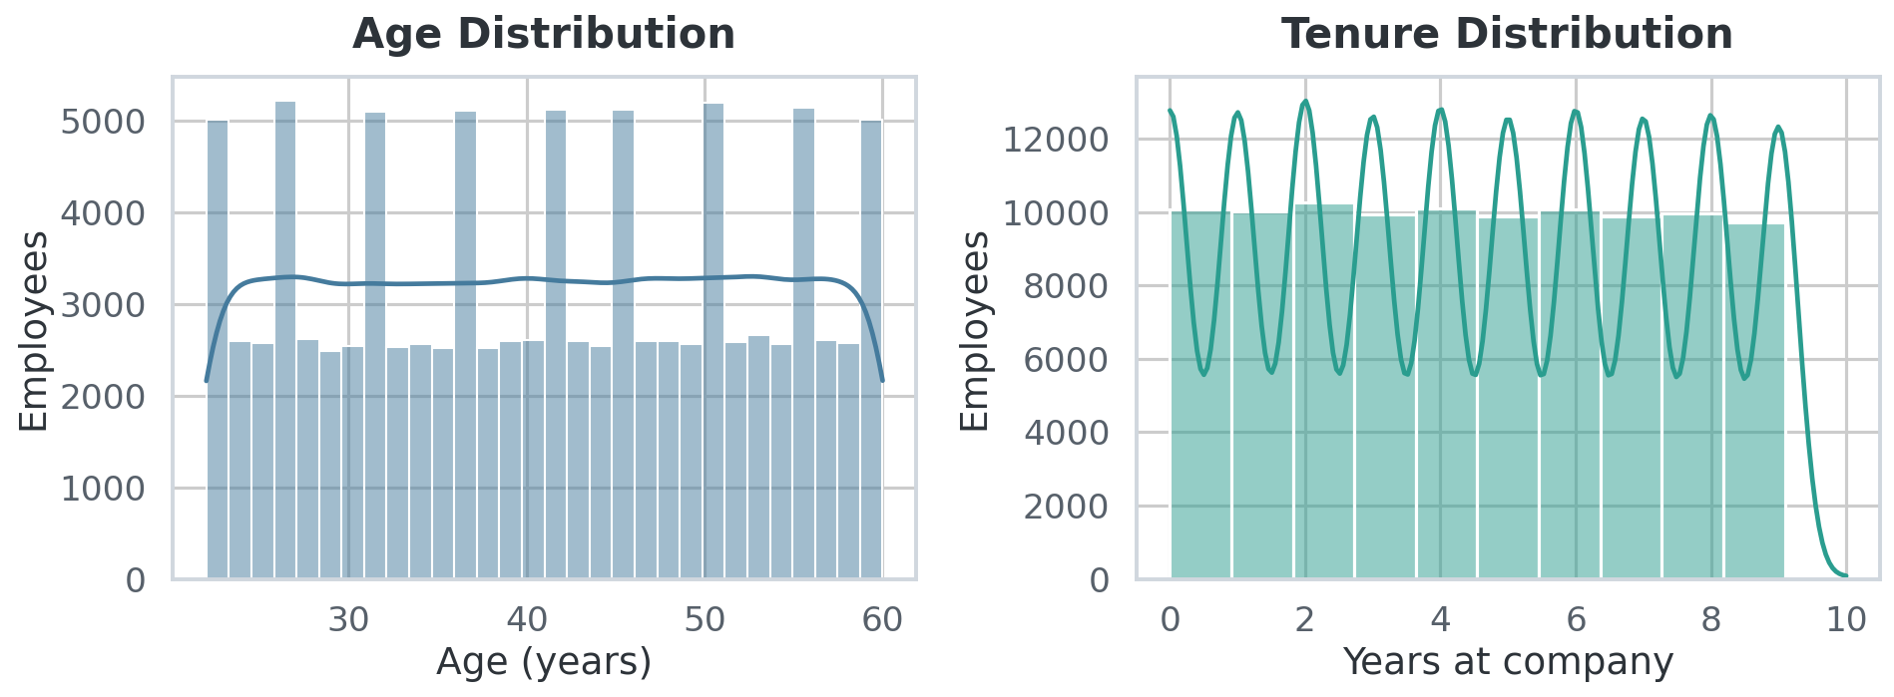
Hiring Trends & Age Profile
Steady hiring 2014–2024; age peaks in the 40s
Average age 41 · average tenure 4.5 years — a mature, stable workforce profile.
Employee Performance & Productivity Analytics · 100,000 employees · 2026
5

Slide 6
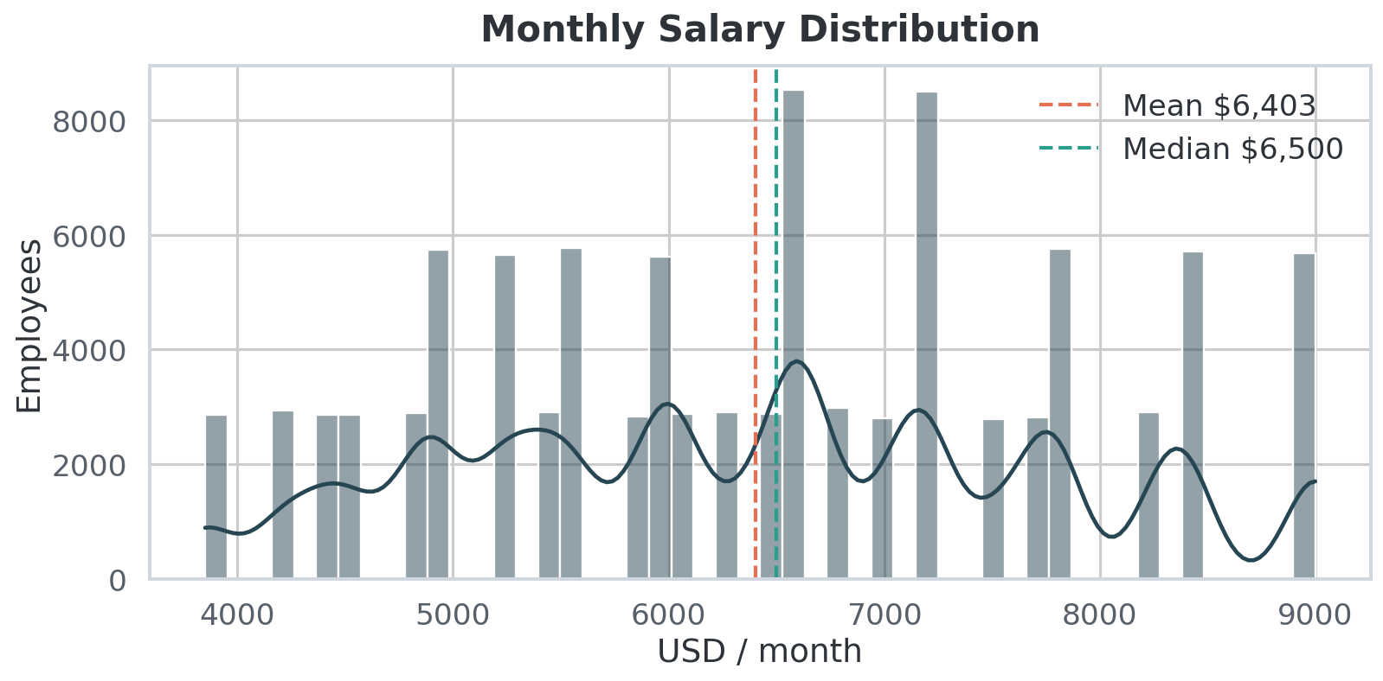
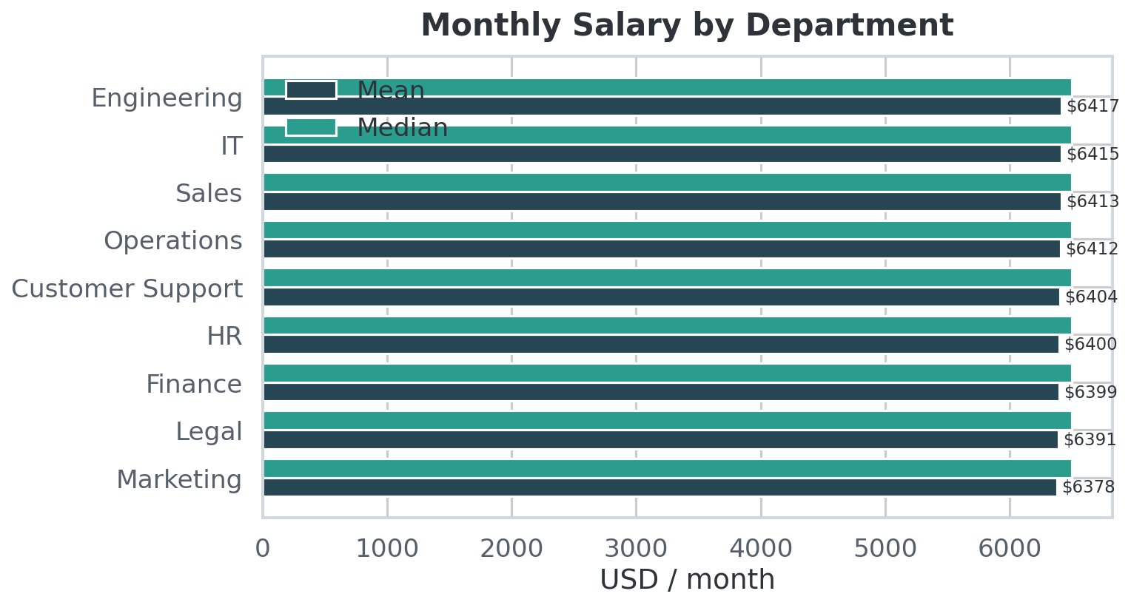
Compensation Overview
Mean $6,403 · median $6,500 · σ $1,373
Near-normal salary distribution, $3,850–$9,000.
Departments differ by just $39/month on average — pay is not department-driven.
Employee Performance & Productivity Analytics · 100,000 employees · 2026
6

Slide 7
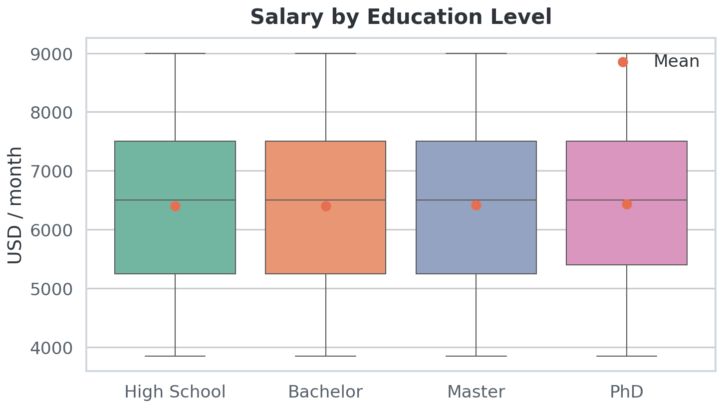
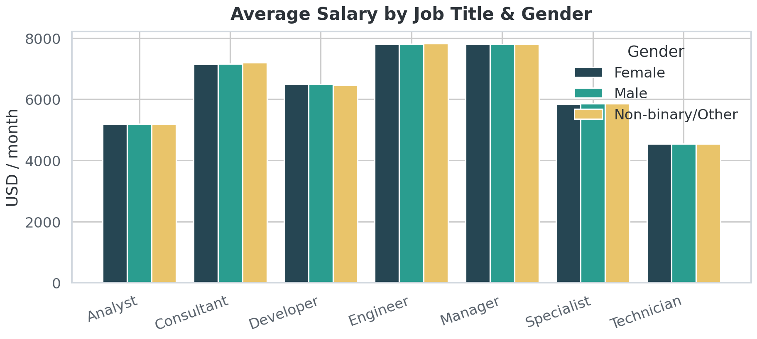
Education & Gender Pay Equity
Small education premiums · no gender gap to remediate
Company-wide: women +$4.50/mo vs men. Largest within-title gap: Consultant +$23 (0.3%).
Verdict: pay equity is healthy — institutionalize quarterly monitoring.
Employee Performance & Productivity Analytics · 100,000 employees · 2026
7

Slide 8
What Drives Salary — OLS Model
R² = 0.991 · MAE = $95 on 20% hold-out — pay is essentially a formula
Job title: Engineer +$2,600 /mo
Pay governance is transparent and rule-based — good for fairness.
But performance ratings now directly move pay by up to $1,972/mo (score 1→5) — rating quality is a compensation-control issue.
Score 1–5 maps to ≈ $4,430–$6,400/mo for a Specialist; titles shift the whole curve.
Job title: Manager +$2,599 /mo
Job title: Consultant +$1,951 /mo
Job title: Developer +$1,300 /mo
Job title: Specialist +$650 /mo
Job title: Technician −$648 /mo
Performance score, per point +$493 /mo
Dept, gender, education, age, tenure… ≈ $0 (|β| < $3)
Employee Performance & Productivity Analytics · 100,000 employees · 2026
8

Slide 9
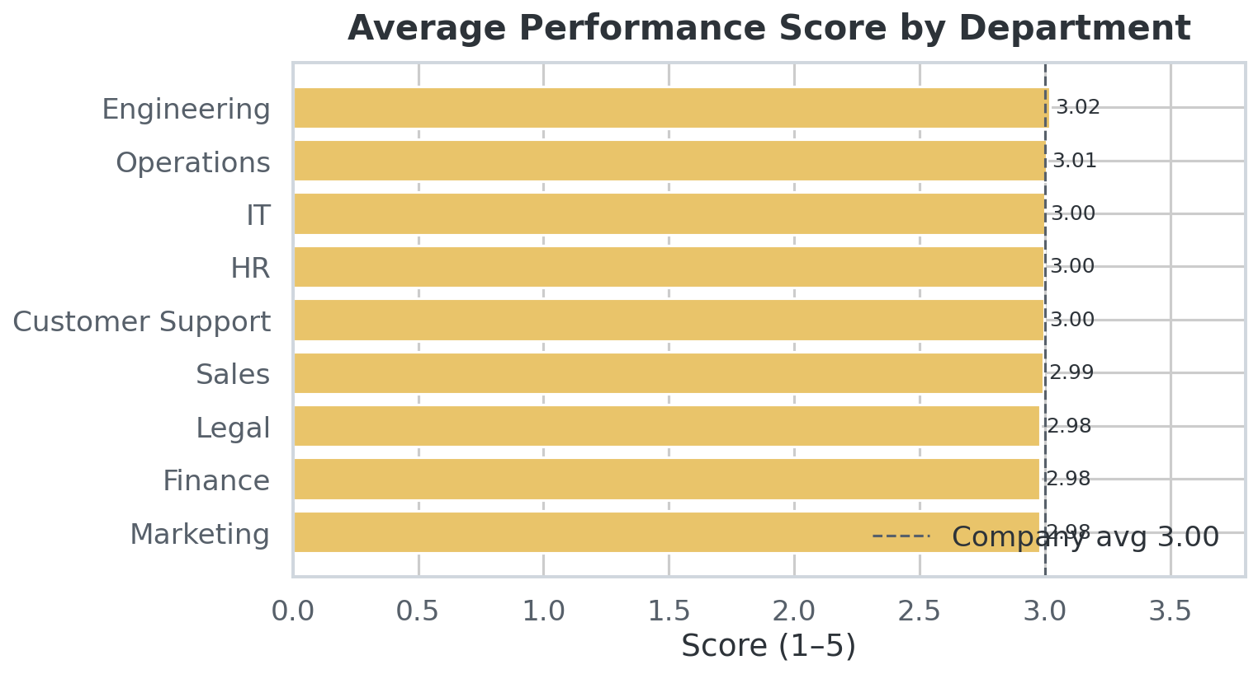
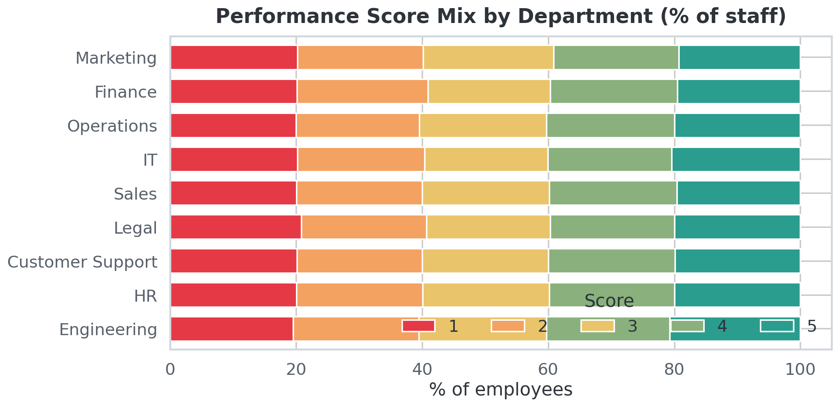
Performance Analysis
Uniform 1–5 distribution · department averages 2.98 – 3.02
39.9% high performers (4–5) vs 40.1% low (1–2) — a perfectly symmetric spread, unusual for real ratings.
Employee Performance & Productivity Analytics · 100,000 employees · 2026
9

Slide 10
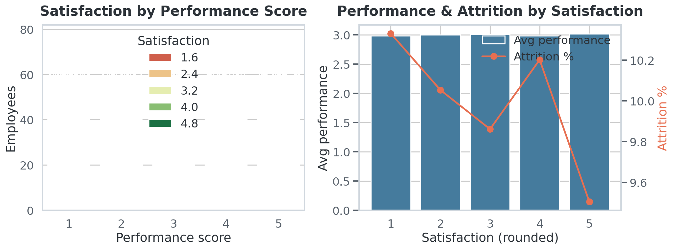
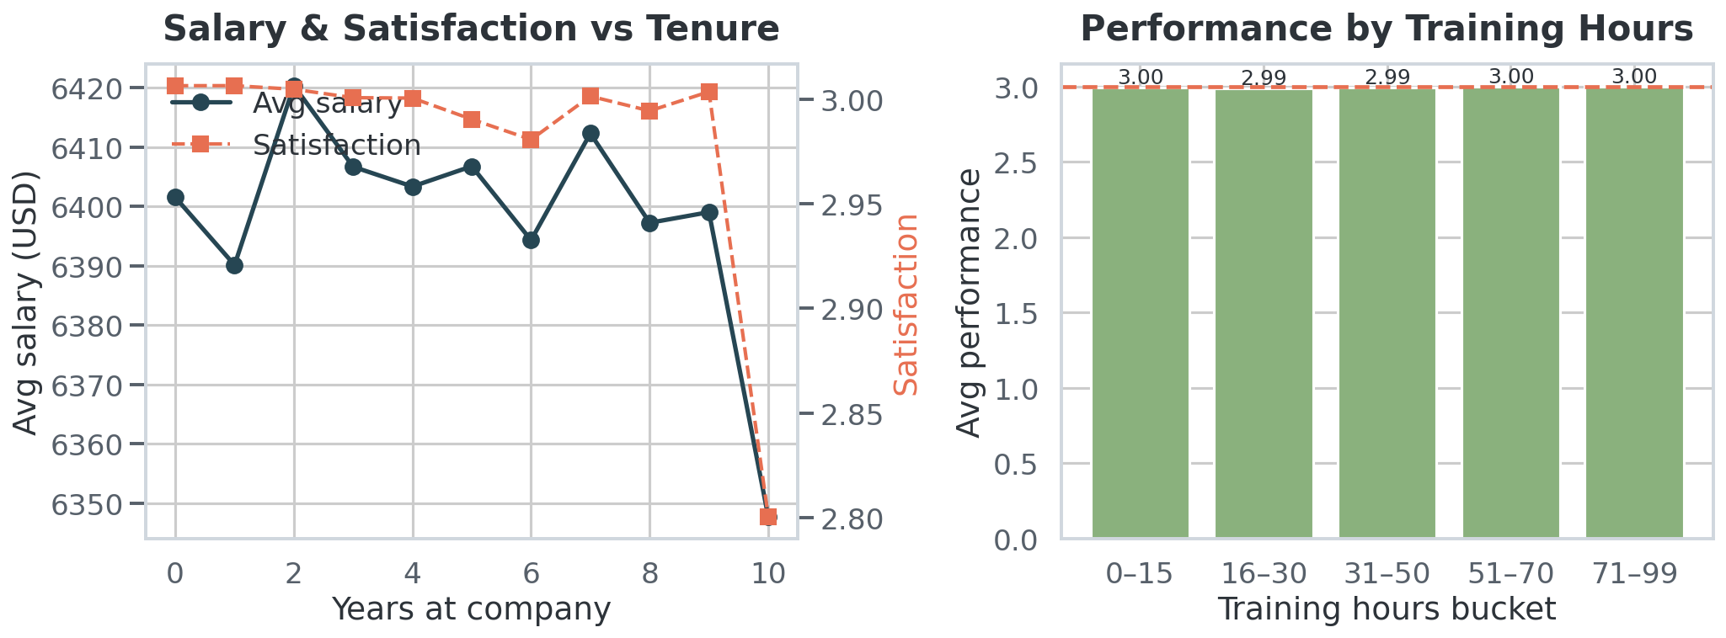
Satisfaction & Training vs Performance
No gradient anywhere — a red flag about measurement
Satisfaction ⊥ performance (r = 0.002) and ⊥ attrition; training hours (0–99) don't move performance at all.
Employee Performance & Productivity Analytics · 100,000 employees · 2026
10

Slide 11
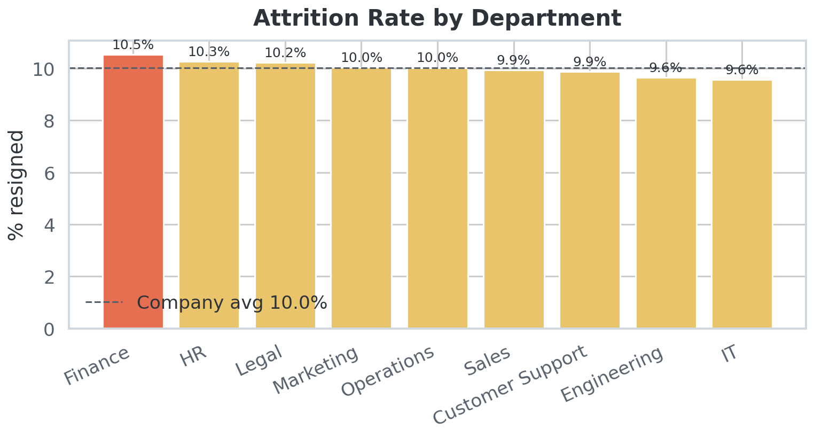
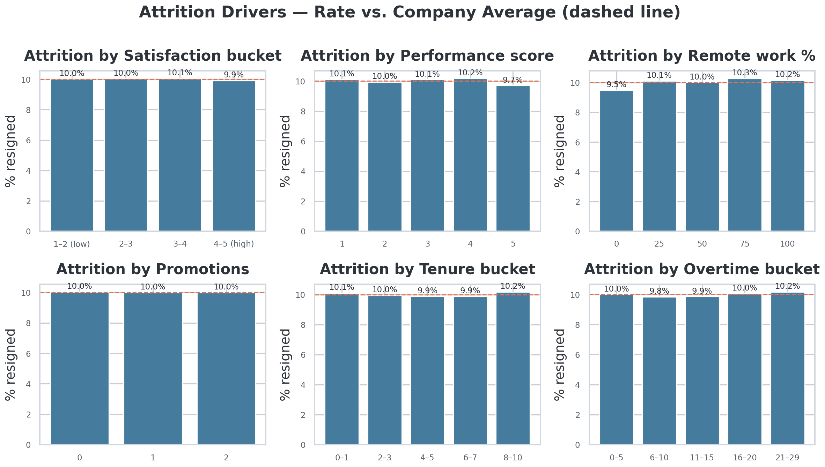
Attrition Overview
10.01% resigned (10,010) — remarkably flat across the organization
Widest department spread: Finance 10.5% vs Engineering/IT 9.6% — well within noise.
Employee Performance & Productivity Analytics · 100,000 employees · 2026
11

Slide 12
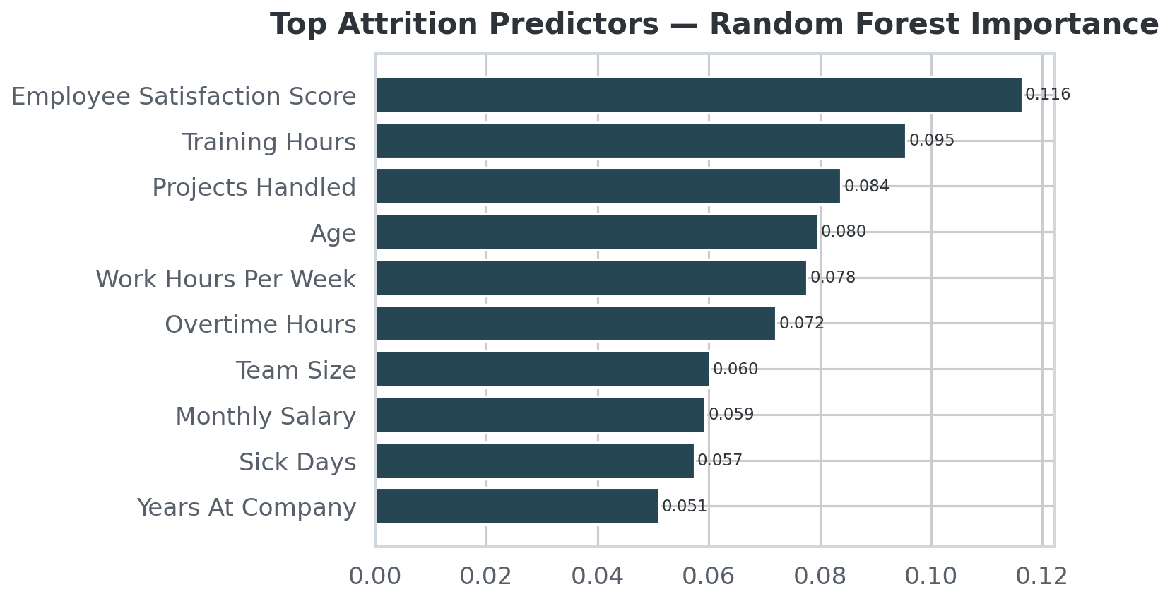
Predicting Attrition — An Honest Negative Result
Both models discriminate no better than a coin flip
0.49
Logistic AUC
0.49
Random Forest AUC
0.90
Accuracy = majority-class baseline
All coefficients within ±0.033; all feature importances < 0.002.
Every segment (satisfaction, performance, tenure, remote, overtime) sits within 9.5–10.3% of the 10.0% rate.
⇒ No flight-risk model is buildable from current fields.
⇒ Action: audit the Resigned flag, capture exit-interview themes & manager ratings, then re-run this pipeline.
Employee Performance & Productivity Analytics · 100,000 employees · 2026
12

Slide 13
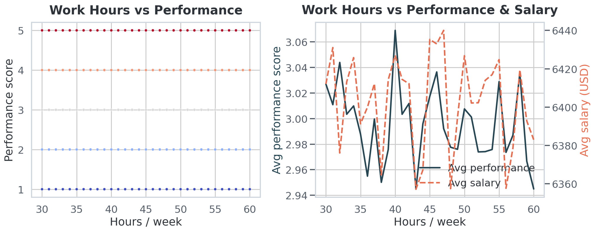
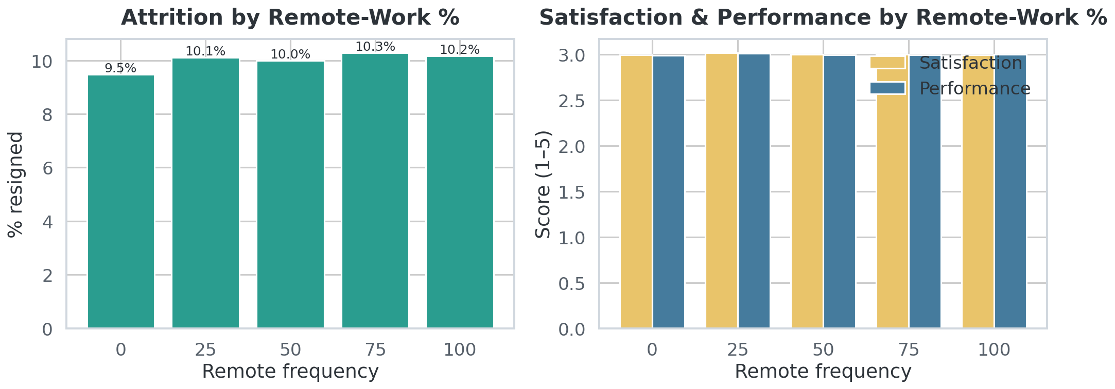
Workload, Remote Work & Balance
45h weeks · 14.5h overtime — and no measurable cost or benefit
Attrition is 9.5–10.3% at every remote-work level; overtime and sick days show no burnout signal.
Employee Performance & Productivity Analytics · 100,000 employees · 2026
13

Slide 14
Key Takeaways & Recommendations
1
Protect pay equity
Gaps < 0.4% everywhere. Automate the quarterly audit (already scripted).
2
Audit performance measurement
Scores drive $493/mo per point yet correlate with nothing — verify they are evidence-based.
3
Fix attrition data capture
AUC 0.49 means leavers are invisible. Validate the flag; add exit themes & manager scores.
4
Pilot, don't blanket-invest
Training/overtime/remote levers show zero effect — test with controlled pilots.
5
Automate the monitor
The pipeline rebuilds everything (charts → dashboard → report → deck) in < 1 min. Schedule it.
Employee Performance & Productivity Analytics · 100,000 employees · 2026
14

Slide 15
Methodology & Reproducibility
Data: 100,000 × 20 CSV — zero nulls, zero duplicate IDs, no cleaning required.
EDA: pandas 2.2 · 20 publication charts in matplotlib/seaborn · Pearson correlations.
Models: scikit-learn 1.6 — LogisticRegression (C=0.5, scaled) & RandomForest (250 trees, depth 8) for attrition; OLS for salary. 80/20 stratified split, seed 42.
Deliverables generated by one pipeline: charts/, dashboard.html (offline, Chart.js inlined), report.pdf (16 pp), presentation.pptx, insights workbook (xlsx), README for GitHub.
Rebuild: python3 src/analysis.py → build_dashboard.py → build_report.py → build_pptx.py → build_workbook.py
Caveat: feature independence + near-perfect salary formula indicate synthetic data — treat results as a validated methodology demo.

